Slide 1

Desktop Assistant project
Author: Nazish Haider
Notes:
Preworks course home assignments

Slide 2
Acknowledgements
Special thanks to the Ms. Shivani Srivastava who guided me to learn and understand the concept of AI and helped me to be able to successfully complete my Desktop Assistant project.

Slide 3
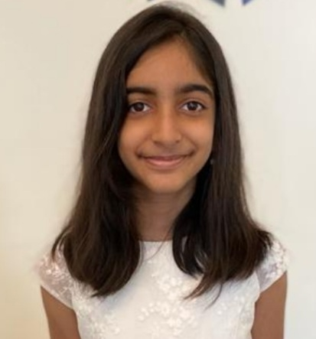
About Me..
Name: Nazish Haider
Age: 11 y/o 6th grade
Nationality: Indian

Slide 4
About My Internship Journey with Clevered
My internship journey with Clevered has been a great learning experience with the help of the very dedicated mentors and assistance received.

Slide 5
About App..
I have chosen to make the desktop assistant project because makes things easier and faster to do on your device with simple verbal commands. It is beneficial to the society as it is always available 24/7 when we need it, helps organize the tasks hence improves the productivity.

Slide 6
How do I use the App?
To give in commands for the assistant we only have to click in the mic button and say “Open appname”.
I have created a Help button for guidance for the user of my app if any assistance is needed

Slide 7
Contact Person
Email address:- nazish17haider@gmail.com

Slide 8
Thank you!

